Slide 1
Careers In Technology
Tori Tompkins
Name 2
Name 3

Slide 2
About Me

Slide 3


Slide 4


Slide 5
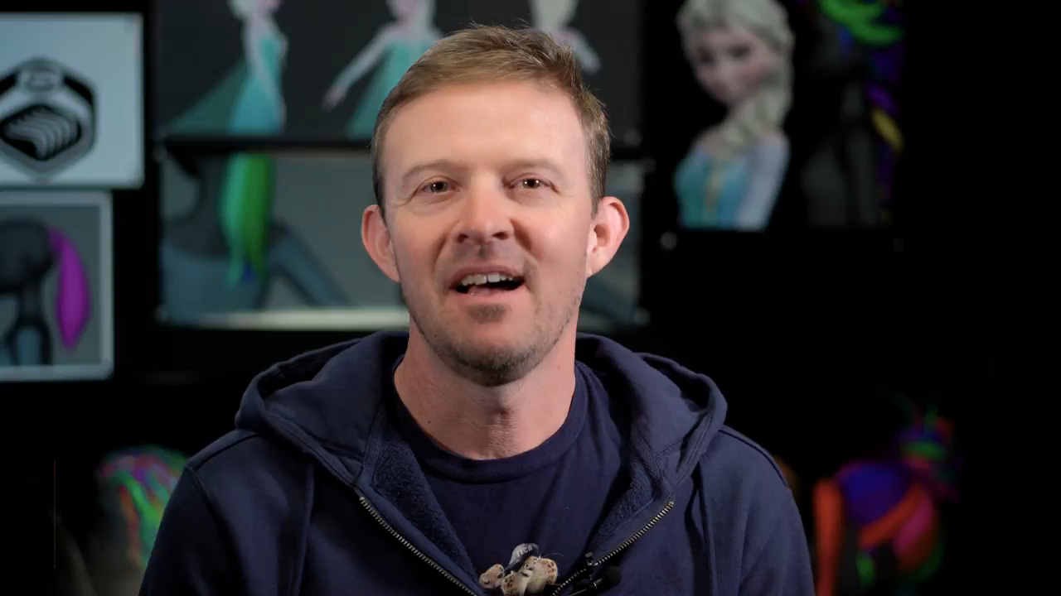

Slide 6


Slide 8
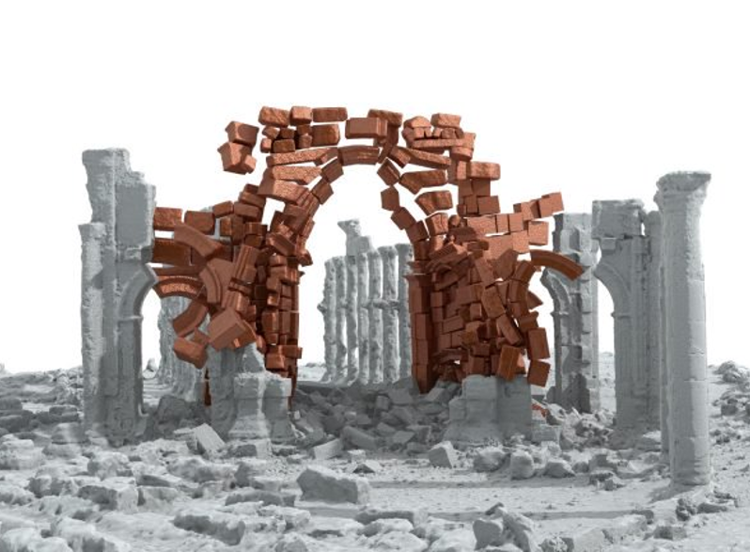
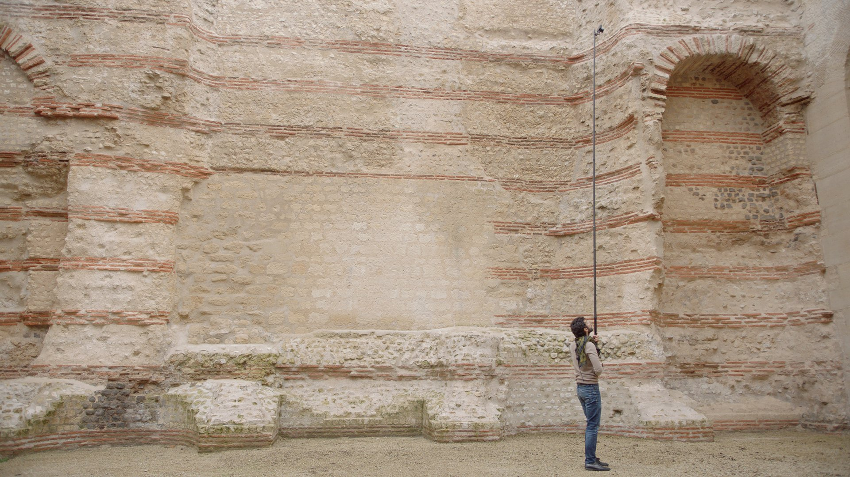

Slide 9
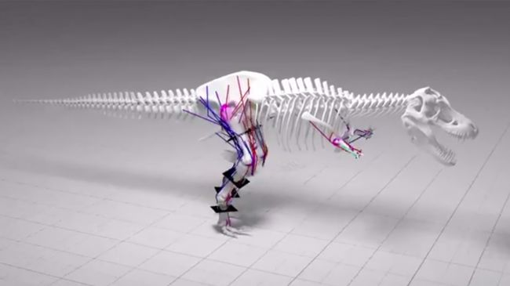

Slide 10
Schedule
Kahoot Quiz
Scratch Workshop: Create a chase game
Micro:Bit Workshop
Design Workshop: Smart Devices
Prizes throughout the day!

