Slide 1
Design Session: Smart Devices
Name 1
Name 2
Name 3
@GirlsCodeTooUK
www.girlscodetoo.co.uk

Slide 3
Smart Device
A smart device is an electronic gadget that is able to connect, share and interact with its user and other smart devices.

Slide 5
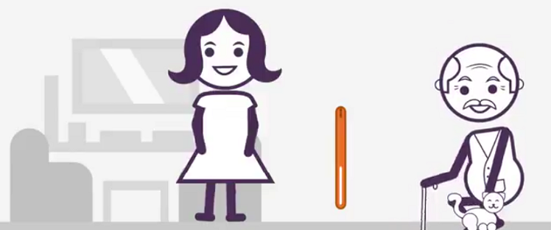

Slide 7
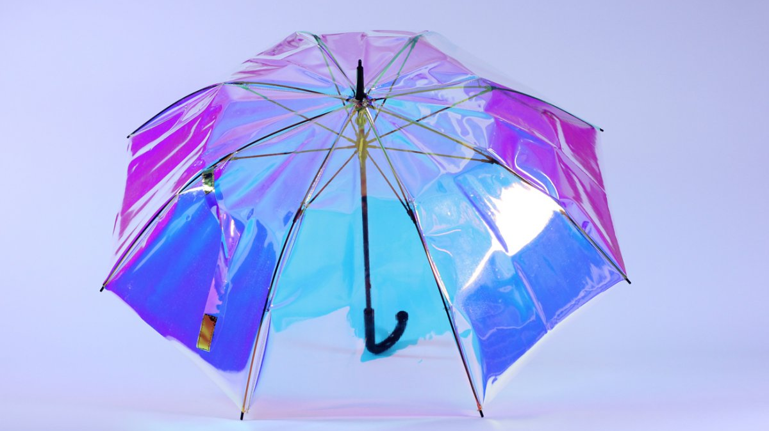

Slide 8
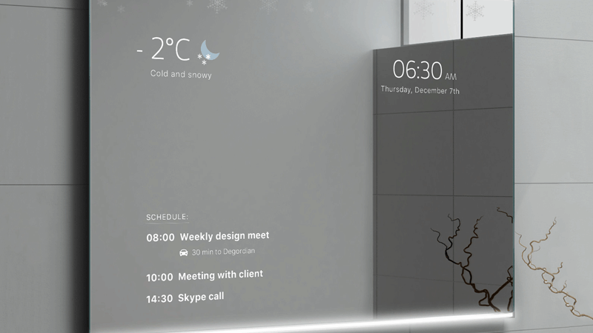

Slide 9
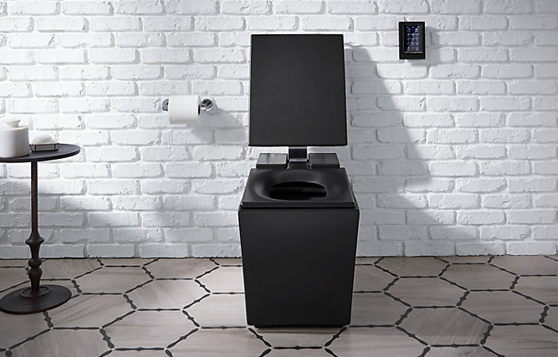

Slide 10
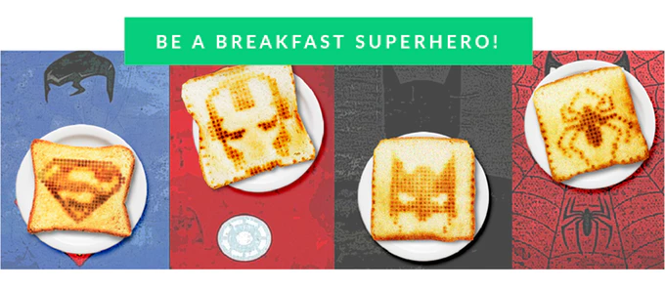
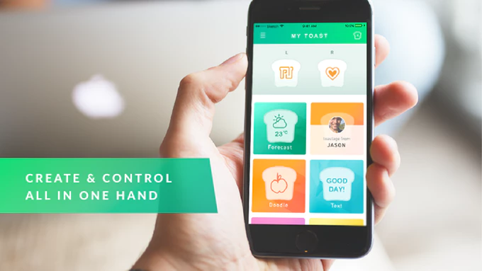
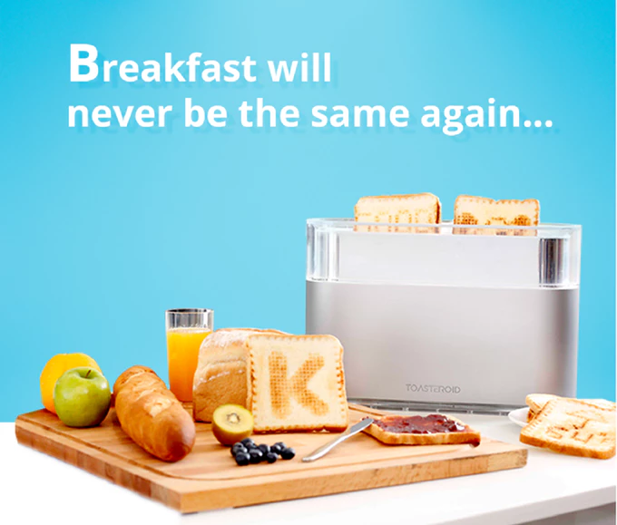

Slide 11
Design Your Own Smart Device
Get into groups of 2 or 3
Create a name for your smart device
Design what it will do
Prepare a short presentation
Most voted for presentation wins prizes!!

